Slide 1

Project 4 Demo 2
Alicia Smith | A00267161

Slide 2
Project Overview: Android Application to retrieve Spotify song recommendations based on user’s top songs from listening history
Recap
(Demo 2)
Tools: Spotify API, Python, data visualisation
Suggestions from demo21: -Refine and focus features -Work on enhancing existing features
-

Slide 3
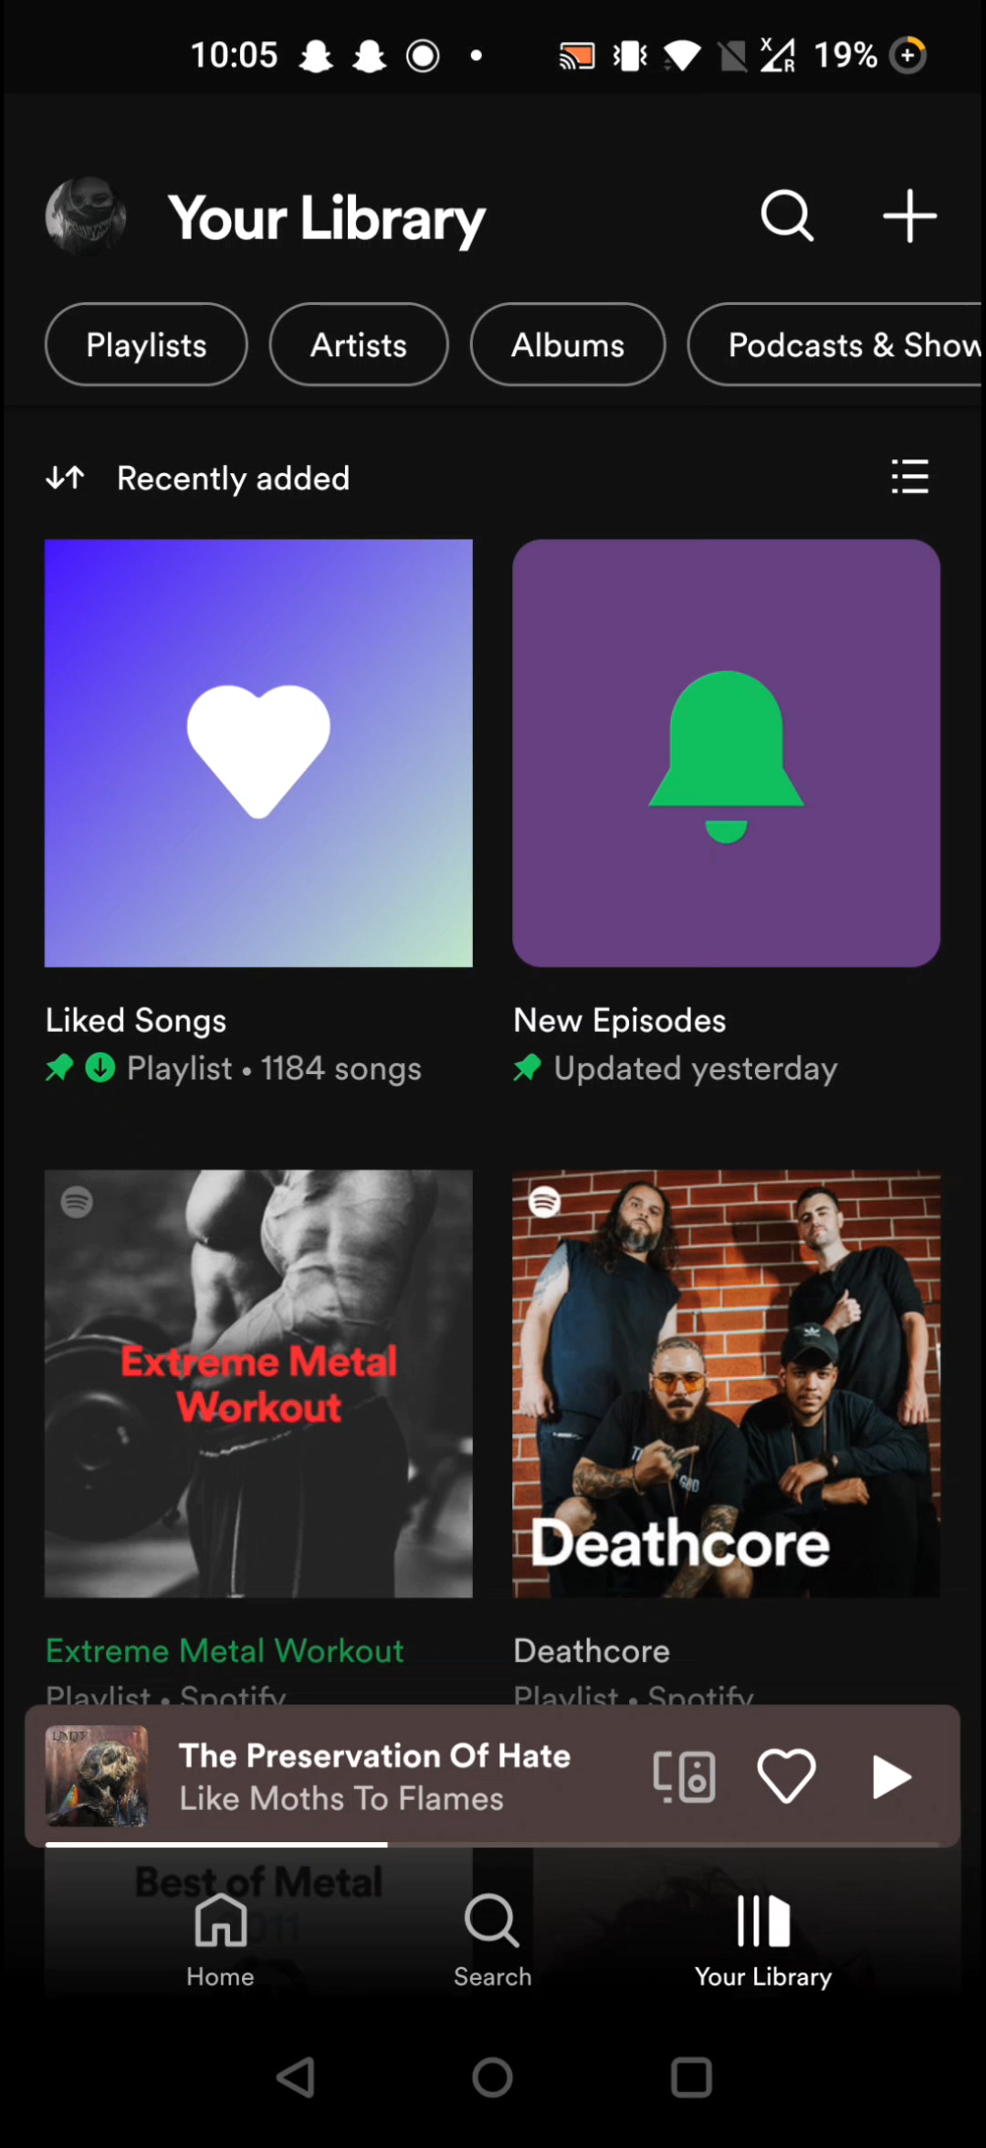
Progress
As music listener I want to see my top played artists So I can gain insight into my listening history | Done
As music listener I want to see my top played tracks So I can gain insight into my listening history | Done
As music listener I want to add my top tracks to a playlist So I can listen to my favourite song | Done (temporary for demo purposes today)
As music listener I want to get recommendations from someone’s listening history So I can listen to similar music | Done
As music listener I want to save recommendations to a playlist So I can listen to them in Spotify | Done
As music listener I want to view visualisations of my top tracks so I can gain insight into my listening history | Done

Slide 4
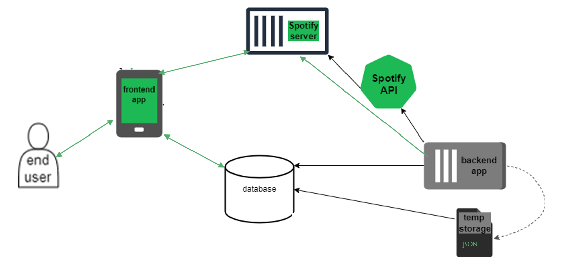
OLD Architecture

Slide 5
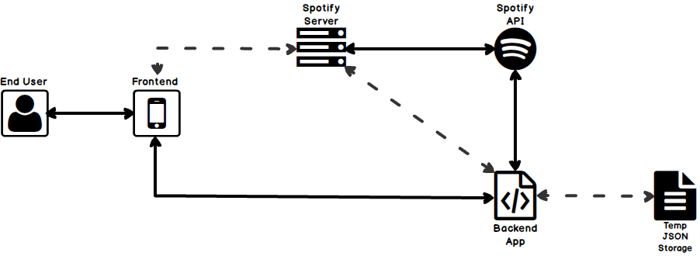
New Architecture

